Slide 1
SELECT OPTIONS
Instructor:

Slide 2




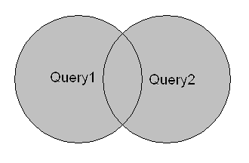
Learning Goals
By the end of this lecture students should be able to:
Understand and use SQL functions
Use Group, Having, Order clauses to built queries
Copy data from one table into another, combine the result-set of two or more SELECT statements
A - Z

Slide 3
Table of contents
SQL Clauses
SQL Functions
Other Options

Slide 4
SQL CLAUSES
Section1

Slide 5
Grouping by clause
Sometimes we want to apply aggregate functions to groups of rows.
Example, find the average mark of each student.
Syntax:
SELECT column_name, aggregate_function(column_name)
FROM table_name
WHERE column_name operator value
GROUP BY column_name;
Id | Name | SubjectID | Mark
1 | John | DBS | 76
2 | John | IAI | 72
3 | Mary | DBS | 60
4 | Mand | PR1 | 63
5 | Mand | PR2 | 35
6 | Jane | IAI | 54
SELECT Name,
AVG(Mark) AS Average
FROM Grades
GROUP BY Name
Group
Name | Average
John | 74
Mary | 60
Mand | 49
Jane | 54
Grades

Slide 6
Having clause
HAVING is like a WHERE clause, except that it applies to the results of a GROUP BY query.
It can be used to select groups which satisfy a given condition.
Ex:
SELECT Name, AVG(Mark) AS Average
FROM Grades
GROUP BY Name
HAVING AVG(Mark) >= 50
Id | Name | SubjectID | Mark
1 | John | DBS | 76
2 | John | IAI | 72
3 | Mary | DBS | 60
4 | Mand | PR1 | 63
5 | Mand | PR2 | 35
6 | Jane | IAI | 54
Name | Average
John | 74
Mary | 60
Jane | 54

Slide 7


WHERE and HAVING
WHERE refers to the rows of tables, and so cannot use aggregate functions
HAVING refers to the groups of rows, can use aggregate functions and cannot use columns which are not in the GROUP BY
SELECT Name,
AVG(Mark) AS Average
FROM Grades
WHERE AVG(Mark) >= 50
GROUP BY Name
SELECT Name,
AVG(Mark) AS Average
FROM Grades
GROUP BY Name
HAVING AVG(Mark) >= 50

Slide 8
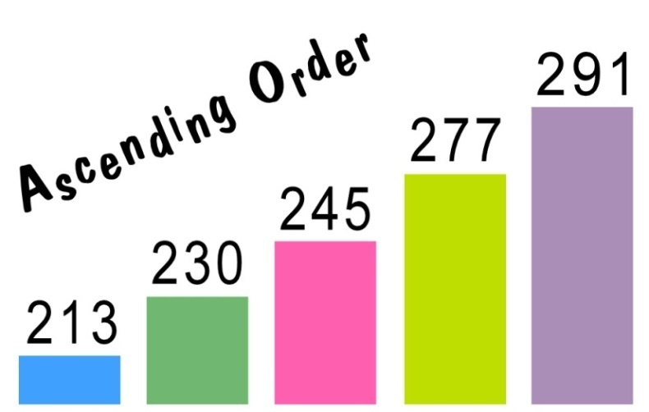
Order by clause
The SQL ORDER BY clause is used to sort (ascending or descending) the records in the result set for a SELECT statement.
Ex:
Syntax:
SELECT column_name, column_name
FROM table_name
[WHERE conditions]
ORDER BY column_name, column_name [ASC|DESC]
Id | Name | SubjectID | Mark
1 | John | DBS | 76
2 | John | IAI | 72
3 | Mary | DBS | 60
4 | Mand | PR1 | 63
5 | Mand | PR2 | 35
6 | Jane | IAI | 54
SELECT Name,
AVG(Mark) AS Average
FROM Grades
GROUP BY Name
ORDER BY Average DESC
Group
Name | Average
John | 74
Mary | 60
Jane | 54
Mand | 49
Grades

Slide 9
SQL FUNCTIONS
Section2

Slide 10
SQL Functions
SQL has many built-in functions for performing calculations on data:
SQL aggregate functions return a single value, calculated from values in a column.
SQL scalar functions return a single value, based on the input value.

Slide 11
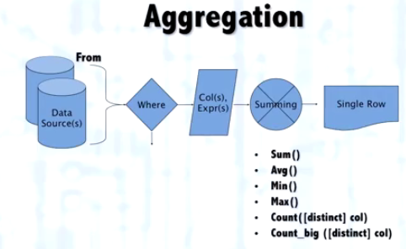

What is an aggregate function
An aggregate function is function that take a collection of values as input and return a single value.
Aggregate functions can be used as expressions only in the following:
The select list of a SELECT statement
A HAVING clause.

Slide 12
Aggregate Functions
Each function eliminates NULL values and operates on Non-NULL values
Function | Description
AVG () | Return the average value in a column
COUNT() | Return the total number of values in a given column
COUNT(*) | Return the number of rows
MIN () | Returns the smallest value in a column
MAX () | Returns the largest value in a column
SUM() | Returns the sum values in a column

Slide 13
Scalar functions
Function | Description
LEN() | Returns the length of a text field
ROUND() | Rounds a numeric field to the number of decimals specified
NOW() | Returns the current system date and time
FORMAT() | Formats how a field is to be displayed

Slide 14
OTHER OPTIONS
Section3

Slide 15
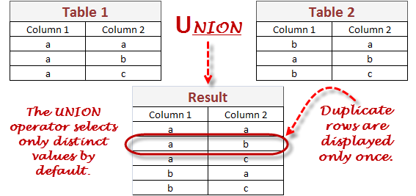
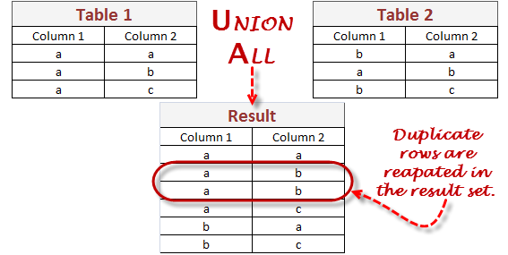
UNION Operator
The SQL UNION operator combines the result of two or more SELECT statements.
Syntax:
SELECT column_name(s) FROM table1
UNION
SELECT column_name(s) FROM table2;
Note: The UNION operator selects only distinct values by default. To allow duplicate values, use the ALL keyword with UNION.
SELECT Column1, Column2 FROM Table1
UNION
SELECT Column1, Column2 FROM Table2;
SELECT Column1, Column2 FROM Table1
UNION ALL
SELECT Column1, Column2 FROM Table2;

Slide 16
SELECT INTO Statement
With SQL, you can copy information from one table into another.
The SELECT INTO statement selects data from one table and inserts it into a new table.
Syntax:
(1): copy all columns into the new table:
SELECT *
INTO newtable [IN externaldb]
FROM table1;
(2): copy only the columns we want into the new table:
SELECT column_name(s)
INTO newtable [IN externaldb]
FROM table1;

Slide 17

INSERT INTO SELECT Statement
The INSERT INTO SELECT statement selects data from one table and inserts it into an existing table.
Any existing rows in the target table are unaffected.
Syntax:
Copy all columns from one table to another, existing table:
Copy only the columns we want to into another, existing table:
INSERT INTO table2 SELECT * FROM table1;
INSERT INTO table2(column_name(s)) SELECT column_name(s) FROM table1;

Slide 18

Summary
SQL Clauses
Group by, Having, Order by
SQL Functions
Aggregate, scalar functions
Other Options
UNION Operator, SQL SELECT INTO, INSERT INTO SELECT
Demo

Slide 19
Thank you

